Slide 1


Absurd certificates
Isabelle Cibois-Honnorat
Michaël ROCHOY
Cyril BEGUE
Sylvain BOUQUET
Modson Idriss TAVAZE
Paul FRAPPÉ
Raphaël DACHICOURT
Artworks by SANAGA
Notes:
Medical time must be preserved, in particular by reducing the administrative burden on doctors.
In March 2023, the french College of General Practice launched the absurd certificate website (certificats-absurdes.fr) to highlight this situation

Slide 2

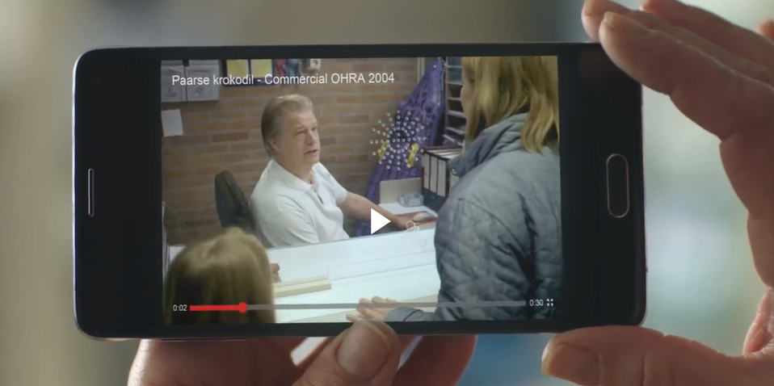
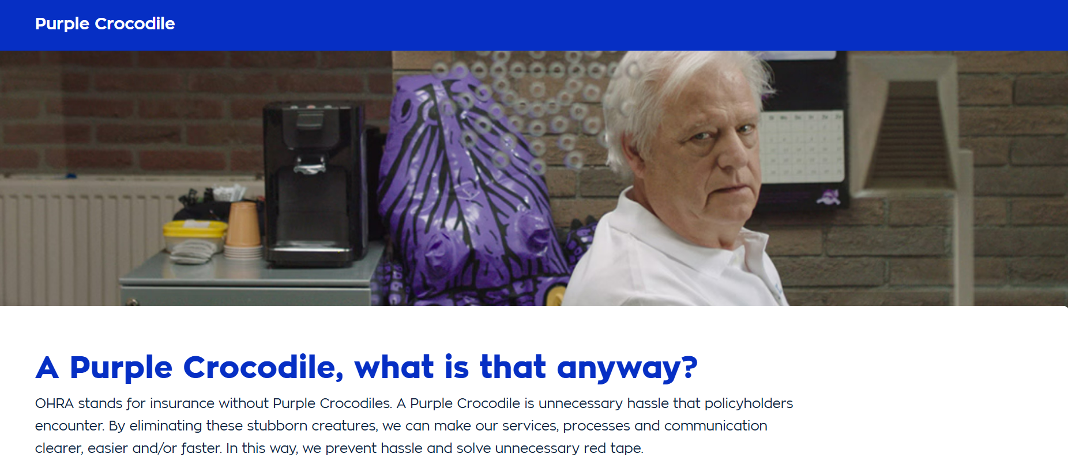
Starting with Netherlands - 2004
Notes:
The Purple Crocodile was first seen in a TV commercial in 2004.
In the commercial, you see an exasperatingly bureaucratic swimming pool employee.
He refuses to return a forgotten Purple Inflatable Crocodile to a young girl.
The commercial was a huge success at the time.
In recent years, the Purple Crocodile has become a symbol in everyday language for useless and unnecessarily complicated bureaucracy.
An anti-bureaucracy law was even named after the Purple Crocodile.

Slide 3


Going on with Belgium - 2022
Notes:
The crocodile became blue, with the same aim.

Slide 4
Then in France - 2023
Notes:
This is a French version of the “Blue Crocodile” action carried out in Belgium in January 2023 with the same aim.
(Many thanks to the illustrator SANAGA)
This is the context with a graphic showing the -negative- evolution of the number of GPs in regular practice between 2010 and today in France.

Slide 5


Collaborative project with medical association "Ordre des médecins" OdM
Identify and describe
requests received
Respond individually to abusive applicants with a letter from the Departmental OdM president
Notes:
We carried out a collaborative project with 10 departmental councils of the medical association which regulates the ethics of the profession (Ordre des médecins OdM) . They were nearby the principal investigator
Aim of our research: to describe the reasons for medical certificates over a period of 100 days and to identify the main applicants for abusive certificates

Slide 6
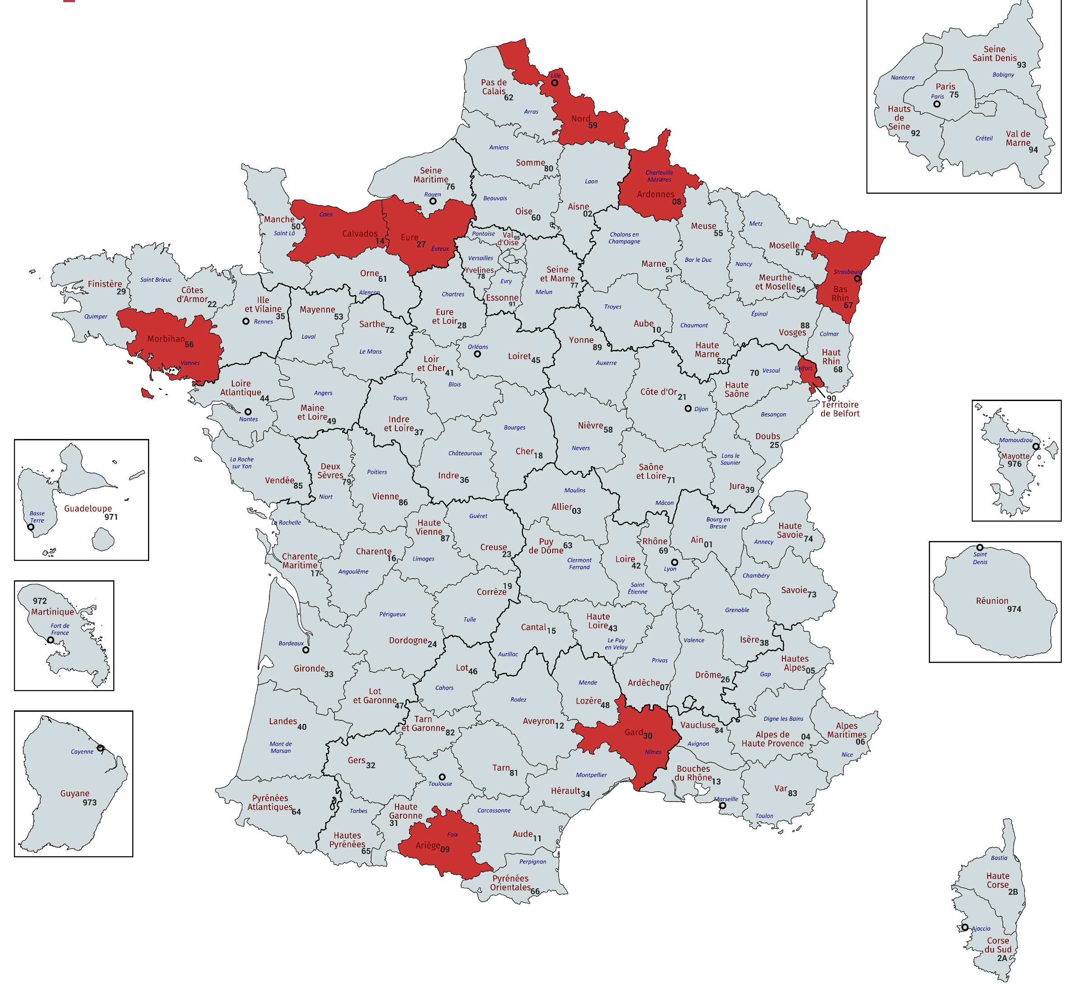
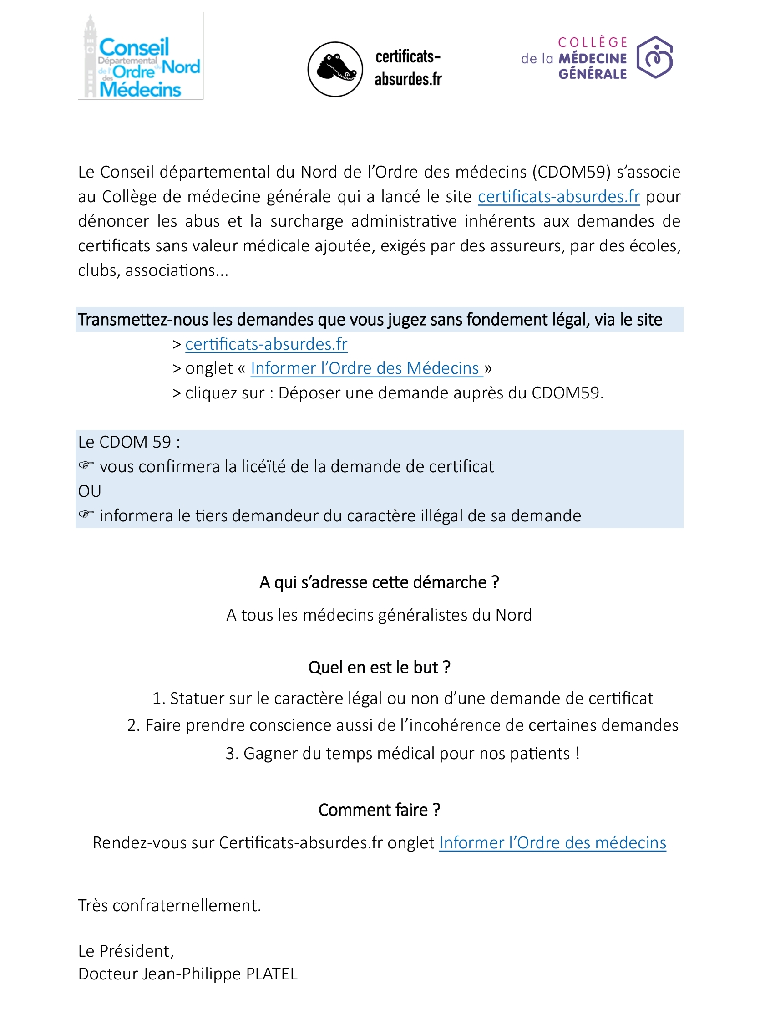
Multicenter descriptive study
(July 8th – October 15th 2023)
Notes:
the OdM of 9 departments received the reports from GPs concerning requests deemed to be abusive.
When the requests were illegal or unjustified, we drafted a letter that was signed and sent by the OdM to the requesting organizations.

Slide 7
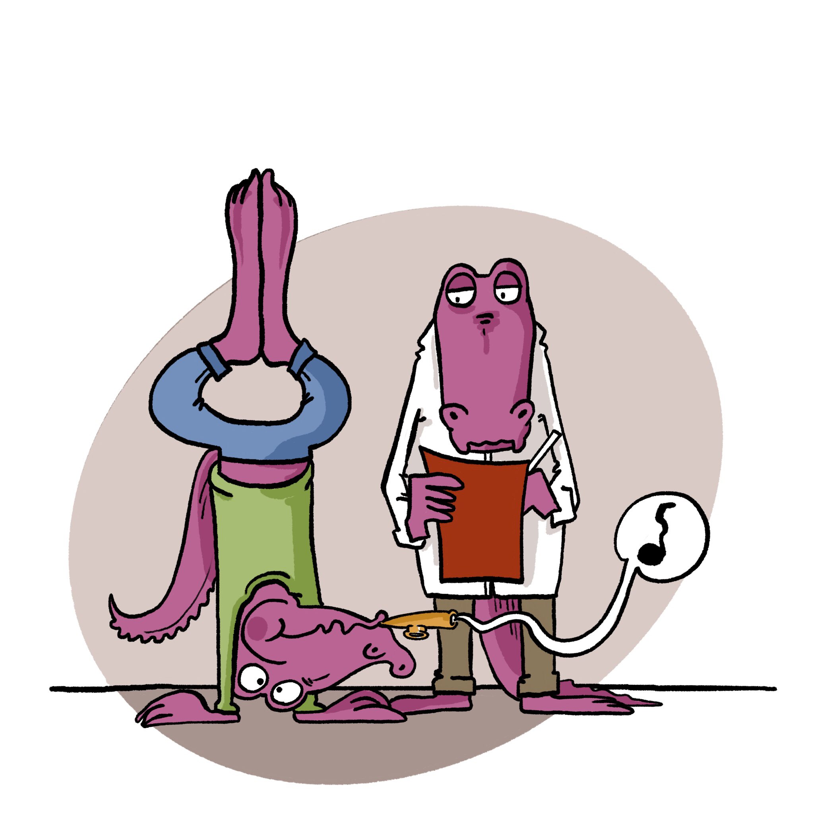
Results : 203 complaints, from 103 doctors
53
50
Contracts
Others
(Sports)
Work
Caring
School
Notes:
203 complaints, from 103 doctors were collected.
The largest number of claims (71=30%) concerned contracts (insurance and provident funds),.
The school and extracurricular environment followed with 61 requests (30%).
Other (58 or 28.6%), which includes sports and all requests that could not be classified elsewhere
Of all the requests for certificates, 164 (80.8%) turned out to be unjustified or illegal, and were the subject of a letter followed by discussions.
After reviewing the legal texts, 164 (80.8%) of the requests for certificates that prompted the doctors to lodge a complaint turned out to have no legal basis, and in some cases were even illegal, as they involved a breach of medical confidentiality
In 38 cases, the request was admissible.

Slide 8


Contracts
- 47 (66%) for an insurance policy (including 37 claiming medical history)
- 9 (13%) following death
- 4 for trip cancellation
School and extracurricular
- 20 (33%) for admission to a school
- 16 (26%) to authorize dispensation of medication
- 2 to go to the toilet, 2 for a locker, etc.
Others
- 20 (34%) no contraindications to sport
- 5 (9%) suitability for civic service missions
Notes:
Just to speak about absurdity in sport:
- each federation has its own rhythm;
- outside federations, everyone asks for what they want

Slide 9
Positive effects
This ground-breaking study has shown that GPs receive numberous requests for medical certificates with no legal basis, particularly from insurance companies.
We avoid between 5,000 and 10,000 requests by the end of the process!
Medical time is wasted on abusive demands that are clearly identified and require simple political action.
One rule should prevail:
without justification, no certificate.

Slide 10
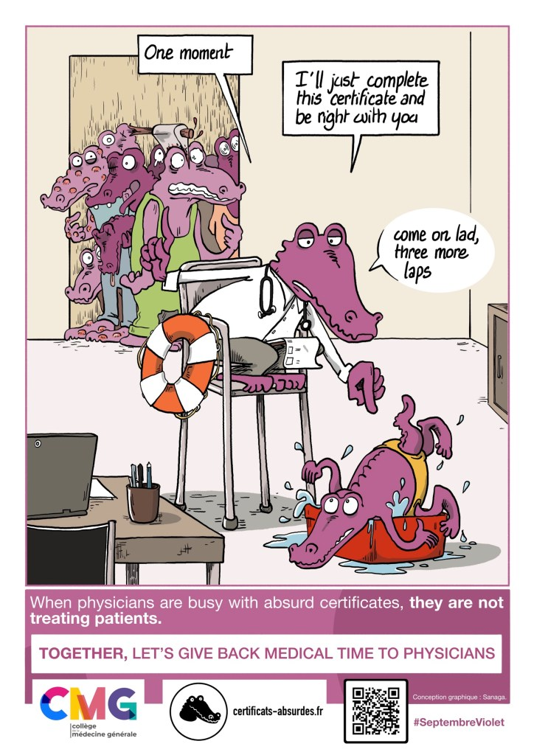
Perspectives: contacts with
Town halls
Schools
Insurers
Sports clubs
A month dedicated each year to combating absurd certificates: Purple September

Slide 11


