Slide 1

Beware of the
purple crocodile
Reducing inappropriate requests for medical certificates: collaboration between certificats-absurdes.fr and 11 Departmental Medical Councils in France
Michaël Rochoy - Idriss Modson Tavaze - Camille Hong
Outreau – certificats-absurdes.fr (Collège de la Médecine Générale)
Artworks © SANAGA - certificats-absurdes.fr
Notes:
Medical time must be preserved, notably by cutting the administrative burden on doctors. In 2023 the French College of General Practice (CMG) launched certificats-absurdes.fr to fight useless certificates. This is joint work with 11 Departmental Medical Councils. Artworks by SANAGA.

Slide 2

THE PROBLEM
Doctors made controllers, not caregivers
In France, the number of GPs is falling while the population grows and ages.
Preserving medical time is now a priority — starting with the administrative load.
1.5-2 h
1976
per GP, every week, spent on
unjustified certificates
« Requests for medical certificates for school absences place a heavy burden on the social security budget and cause substantial loss of time for the medical profession. »
* Sources: DREES 2019 (3 300 GPs)
Lost medical time = lost access to care.
Notes:
GPs estimate spending on average 1.5 to 2 hours per week on unjustified certificates, demanded by insurers, employers, schools, sports clubs and public bodies. Every signature is time taken from care.

Slide 3
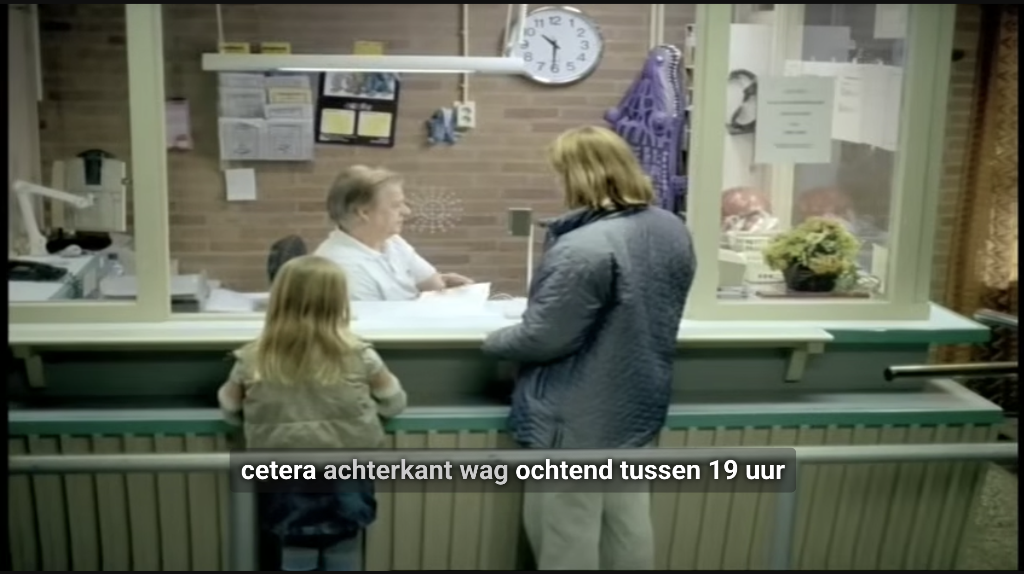

WHERE IT STARTED
The purple crocodile
A 2004 TV advert: an absurdly bureaucratic pool attendant refuses to give a little girl back her forgotten inflatable purple crocodile.
It became the everyday symbol of useless, needlessly complicated red tape.
The Dutch even named an anti-bureaucracy law after it.
OHRA insurance TV advert, 2004 (NL)
2004 Netherlands — purple crocodile
2022 Belgium — the crocodile turns blue
2023 France — certificats-absurdes.fr (CMG)
A public campaign to name, collect and challenge useless certificate requests.
Notes:
The Purple Crocodile first appeared in a 2004 OHRA advert: a maddeningly bureaucratic pool employee refuses to hand back a girl's forgotten inflatable purple crocodile. It became a symbol for useless bureaucracy; an anti-bureaucracy law was even named after it.

Slide 4
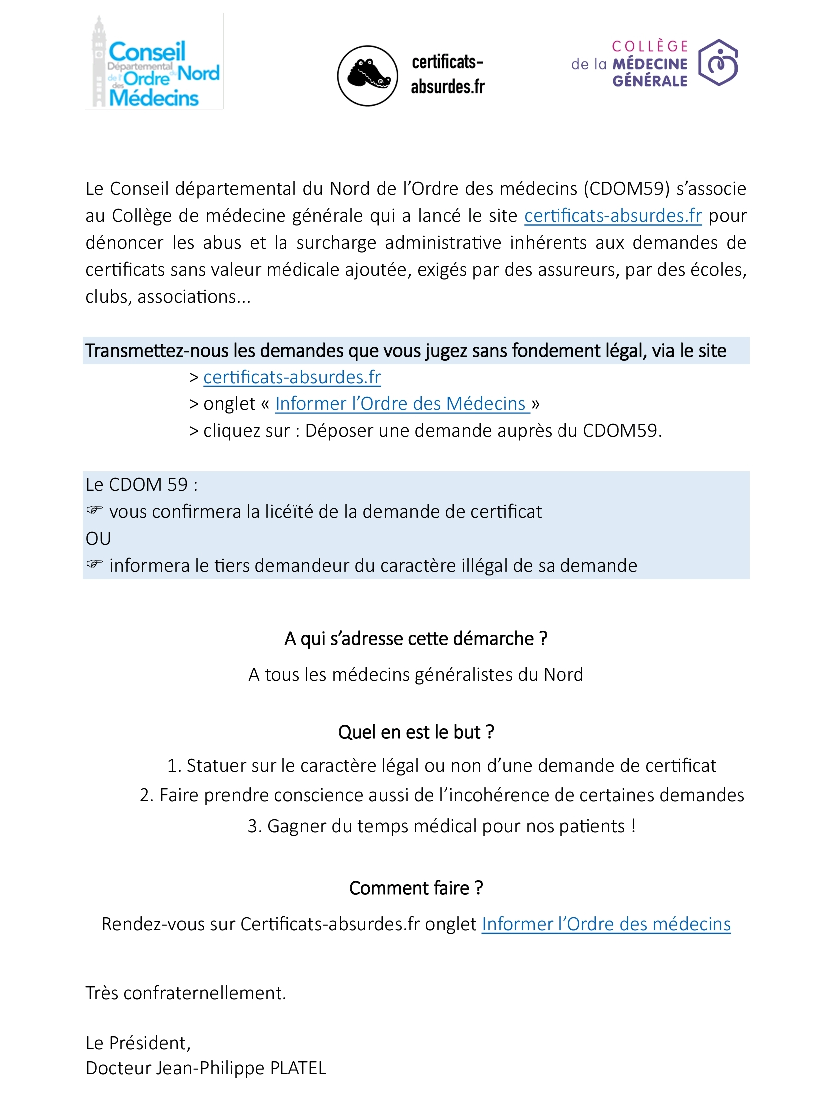
OUR PROJECT
CMG + 11 Departmental Medical Councils
A collaboration with the Ordre des médecins (medical councils that regulate the profession).
1
2
Identify & describe
Respond individually
Collect the certificate requests GPs judge abusive.
Classify each by domain and check its legal basis (LégiFrance).
A personalised letter — signed by the Council president — sent to the requester, citing the law.
Notes:
We ran a collaborative project with 11 departmental councils of the Ordre des médecins (the body that regulates medical ethics). Two aims: identify and describe abusive requests; and respond individually to abusive requesters with a letter from the departmental council president, citing the relevant law.

Slide 5

METHODS
A 2.5-year prospective, multicentre study
Design
Prospective, multicentre, descriptive study
Period
July 2023 → December 2025 (2.5 years)
Setting
11 of 99 Departmental Medical Councils (CDOM)
Inclusion
Every request a GP reported by email as abusive
Response
Personalised legal reply to the GP and the requester
Analysis
Classified by domain; legal status checked on LégiFrance
Notes:
Prospective, multicentre, descriptive study from July 2023 to December 2025 (2.5 years), across 11 of the 99 departmental councils. GPs emailed the requests they considered abusive; a personalised response citing applicable legislation was sent to both the physician and the requester. Each request was classified by domain and its legal status assessed via LégiFrance and council guidance.

Slide 6
RESULTS
423 abusive requests, from across the network
423
78 %
285
certificate requests
reported by GPs
judged abusive or illegal
(incl. confidentiality breaches)
from the lead department
alone (67%)
Confirmed at scale: certificate requests with no legal basis are frequent — above all from insurers and schools.
Notes:
423 complaints were received, 285 (67%) from the lead department. Overall 78% of requests were judged abusive or illegal, including breaches of medical confidentiality. The longitudinal multicentre design confirms the high frequency of requests with no legal basis, particularly from insurers and the school sector.

Slide 7
RESULTS
Insurance and sport lead the demands
Insurance / disability contracts
43% n=180
Training & sport
28% n=118
School & extracurricular
18% n=78
Work & healthcare
11% n=47
N = 423 reported requests (July 2023 – December 2025)
Insurance, school and sport — three targets for simple, political action.
Notes:
Requests mainly concerned insurance or disability contracts (180; 43%), training and sport (118; 28%), school or extracurricular settings (78; 18%), and work/healthcare issues (47; 11%). Three clear targets for action.

Slide 8
THE ABSURD IN PRACTICE
Real requests received by GPs
School
Insurance
Sport & others
Certificate to enter a school
Disclose the patient's medical history
“No contraindication” to any sport
To let a child take medication
Certificate after a death
Fitness for civic-service missions
To go to the toilet — or use a locker
For trip cancellation
Each federation sets its own rules
Notes:
Examples actually received: a certificate to enter school, to authorise medication at school, even to go to the toilet or use a locker; insurers demanding the patient's medical history, certificates after a death, or for trip cancellation; 'no contraindication to sport' for everyone — each federation with its own rhythm, and outside federations anyone asks for anything.

Slide 9

IMPACT
Thousands of abusive requests
intercepted and challenged.
Between 5,000 and 10,000 requests avoided by the end of the process.
One rule should prevail:
No justification, no certificate.
Notes:
This ground-breaking work shows GPs receive numerous requests with no legal basis, particularly from insurers. By the end of the process we avoid between 5,000 and 10,000 requests. One rule should prevail: without justification, no certificate.

Slide 10
BEYOND FRANCE
A shared European problem
GPs across Europe are buried under low-value certificates - and movements are rising to push back.
Sick leave without a certificate?
🇧🇪 Belgium
certificats-absurdes.be
France — not allowed
🇨🇭 Switzerland
SSMIG “Paper Tiger” survey
Germany / Switzerland — ~3 days
🇮🇱 Israel
“Gym Law” · short-term certif · closed list
Sweden / UK — up to 7 days
🇵🇹🇮🇹 Portugal / Italy
APMGF - SNAMI / FIMMG / SMI unions
Netherlands — no certificate at all
🇩🇰 Denmark
doctors–municipalities cooperation
Rules diverge across 30+ countries
Notes:
This is a shared European problem. Movements are emerging: certificats-absurdes.be in Belgium, the SSMIG 'Paper Tiger' survey in Switzerland, Israel's 'Gym Law' and short-term certificate rules, unions in Portugal and Italy, doctor–municipality cooperation in Denmark. Even self-certification of sick leave varies enormously — from none in France to a full week in the UK and Sweden. Surveyed for the European Atlas of General Practice.

Slide 11
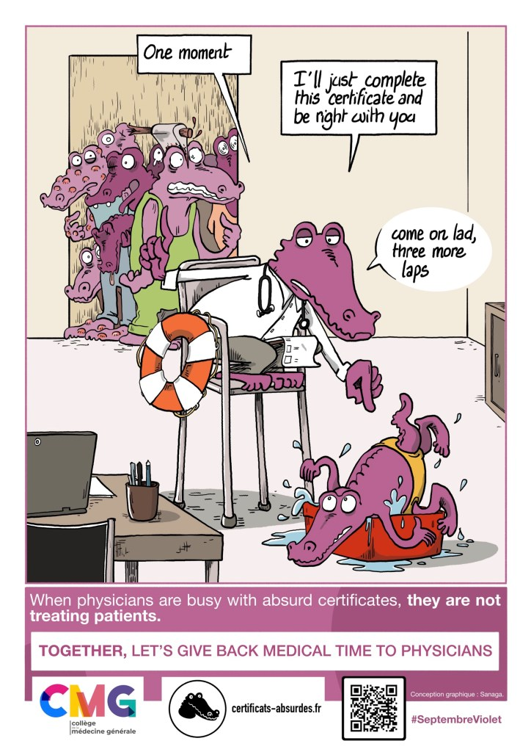
PERSPECTIVES
From local letters to national policy
Purple September — an annual month against absurd certificates.
Engage the issuers
Town halls · schools · insurers · sports clubs
Scale nationally
With the National Medical Council (CNOM) and Health Insurance (CNAM)
Score every rule
In “doctor-years” freed or wasted: a wasted-time yardstick
Notes:
Perspectives: a dedicated month each year — 'Purple September'. Contacts with town halls, schools, insurers and sports clubs. Scaling nationally with the National Medical Council and the national Health Insurance. And a yardstick: in France, 50,000 GPs × ~5,000 consultations = one 'doctor-year'; a useless certificate × a million = 200 doctor-years lost a year. Score every rule in medical-years freed or wasted.

Slide 12

TAKE HOME
Absurd certificates waste
medical time we can’t spare.
Name them, refuse them, act (locally and nationally, ‘cause we are activists)
No justification, no certificate.
Thank you
certificats-absurdes.fr - michael@rochoy.fr - Artworks © SANAGA
Notes:
Take-home: absurd certificates waste medical time we cannot spare. Name them, refuse them, and act locally and nationally. One rule: without justification, no certificate. Thank you — certificats-absurdes.fr. Artworks by SANAGA.

